Slide 1
SPANISH RESTAURANT
NEW YORK CITY RESTAURANTS RESEARCH PROJECT

Slide 2
STUDY OBJECTIVE
the Spanish Chamber of Commerce, in collaboration with the Ministry of Foreign Affairs, considers it appropriate to re-launch the Spanish restaurants in New York City
Spanish food is one of the most valued. The ratings received from diners all over the world exceed the notable ones, with figures that do not go below 4 out of 5 in any case
The pilot project is to be able to open a Spanish restaurant in an area with a high concentration of Spanish community or with a high concentration of Spanish restaurants.
The menu of those restaurants with the best acceptance will be analysed in order to know which is "the recipe of their success".

Slide 3
Data acquisition and cleaning
WEBSCRAPING in different webs about NY DATA:
WIKIPEDIA- https://en.wikipedia.org/wiki/New_York_City
DATA ABOUT NY, LONGITUD, LATITUDE
DATA ABOUT POPULATION, ETHNICAL

Slide 4
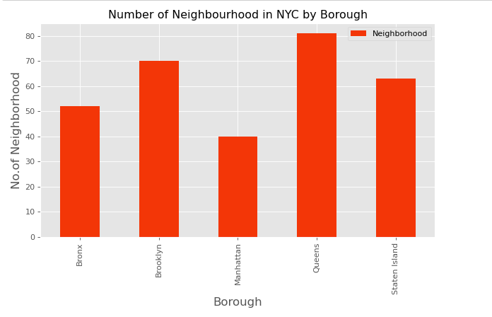

Slide 5
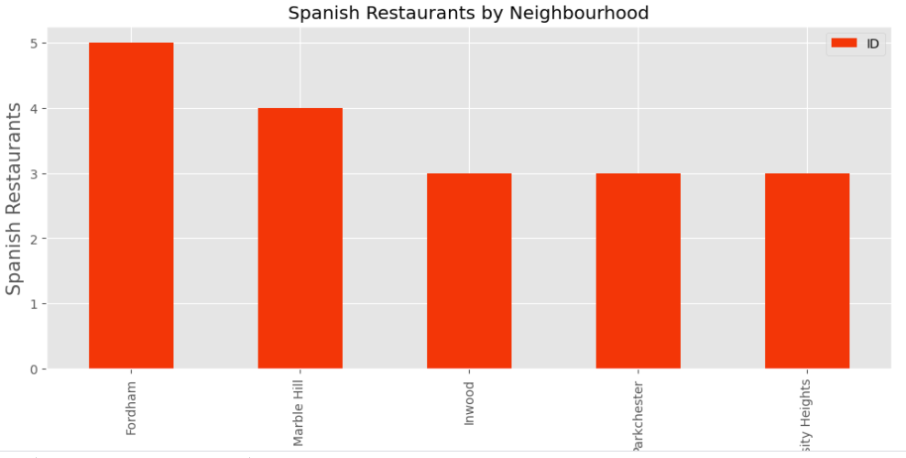
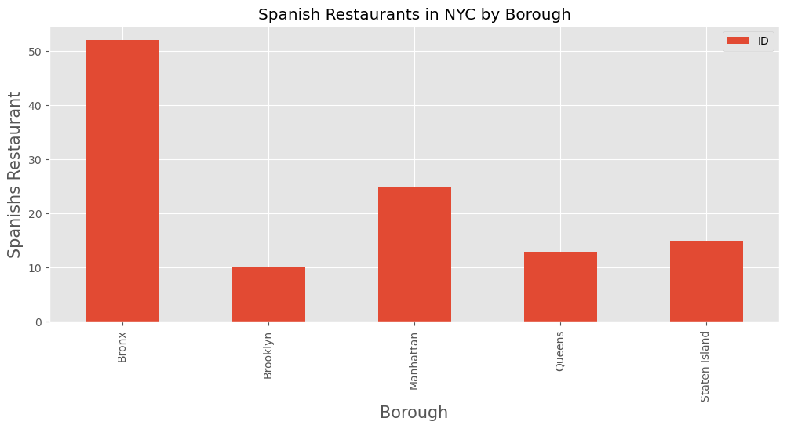
Spanish restaurants

Slide 6
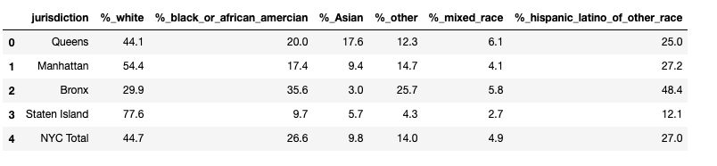
Ethnical and population

Slide 7
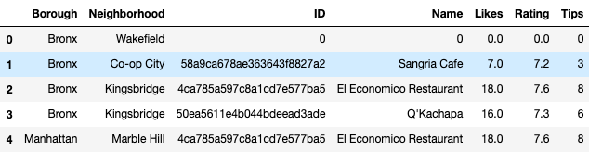
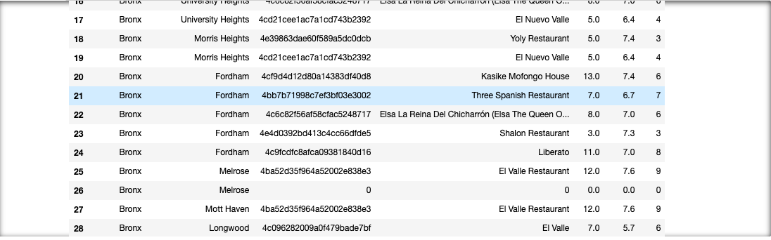
RESTAURANTS

Slide 8
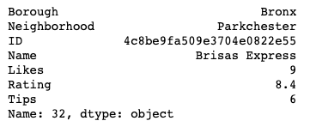
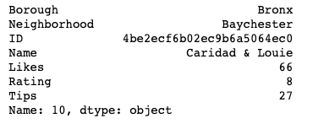
rating
likes

Slide 9
1. NY has a high rate of Spanish restaurants 2. Support of Spanish food by neighborhoods 3. Bronx would be the best option by district, Parckhester or Baychester the best option by rating of its restaurants, Fordham the best neighborhood by the high rate of Hispanic community 4.Analyze the menu of Brisas Express, and Caridad Louie to investigate their products and food
thanks

